Slide 1


Streamlining Your Store: Introducing Our Inventory Management System
Welcome, store owners and managers! We understand the challenges of managing inventory in today's competitive market. That's why we've developed a powerful and user-friendly Inventory Management System tailored to meet your unique needs. This presentation will guide you through the key features and benefits of our system, empowering you to optimize your operations and drive growth.
by J. Deku, I. Mohammed and J. Avorgbedor​

Slide 2
The Problem We Solve: Challenges of Manual Inventory
Manual Tracking
Time-Consuming Processes
Manually tracking inventory is prone to errors, leading to stock shortages, overstocking, and wasted resources. It also makes it difficult to analyze data and make informed decisions.
Maintaining sales and purchase records manually can be time-consuming and tedious, impacting staff productivity and hindering efficiency.

Slide 3

Our Solution: A User-Friendly Inventory Management System
Automation
Efficiency
Our system automatically updates inventory levels with every transaction, eliminating the risk of manual errors and ensuring real-time accuracy.
Data entry is simplified using product codes, retrieving relevant details automatically and speeding up processing times.
Real-Time Insights
Gain real-time visibility into stock levels, transaction details, and sales performance, enabling data-driven decision-making.

Slide 4
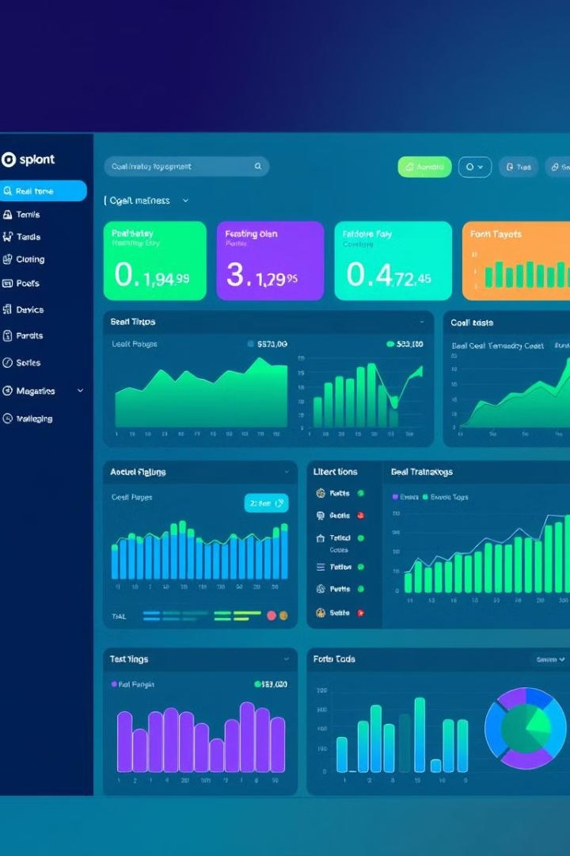
Key Features: Empowering Your Operations
1
Inventory Management
2
Transaction Management
Easily manage stock levels, track product movements, and receive alerts for low inventory.
Record and track sales and purchase transactions, providing detailed reports for analysis.
3
User Roles and Permissions
Implement granular access controls for different user roles, ensuring data security and accountability.

Slide 5



Administrative Features: Enhanced Control and Visibility
User Management
User Logs
Administrators can add, edit, and delete users, assign roles, and manage permissions.
Maintain a detailed log of user activities, including login and logout times, for enhanced accountability and security.

Slide 6

Streamlined Sales Process: Boosting Efficiency
1
2
3
Enter product codes to retrieve relevant details, including pricing, quantity, and availability, automatically.
Process sales quickly and accurately, minimizing errors and improving customer satisfaction.
Generate receipts and track sales data for comprehensive reporting and analysis.

Slide 7





Benefits: Transforming Your Business
Increased Efficiency
Automate processes, streamline operations, and free up staff time for other tasks.
Improved Accuracy
Reduce errors, eliminate stock discrepancies, and ensure accurate inventory counts.
Enhanced Decision-Making
Gain real-time insights into stock levels, sales trends, and customer behavior for informed decisions.
Increased Profitability
Optimize inventory levels, reduce waste, and enhance customer satisfaction, driving revenue growth.

Slide 8

Next Steps: Empowering Your Future
We are confident that our Inventory Management System can revolutionize your store's operations and help you achieve your business goals. Take the first step towards a more efficient and profitable future by contacting us today to schedule a demonstration and learn more about how we can tailor our system to your specific needs. We look forward to partnering with you in your journey towards success.

